Slide 1
Rossmoor Counseling Services
Penny Reed, LCSW

Slide 2
AIM
3 Steps to Stress Inoculation
Anticipate how you will feel
Identify any anxious thoughts or feelings
Manage your responses

Slide 3
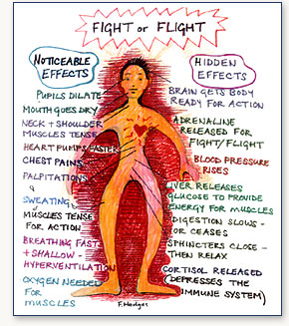

Slide 4
STOP
TAKE A BREATH
OPEN-SOFTEN-OBSERVE
PROCEED

Slide 5
Emotional symptoms
Depression or general unhappiness
Anxiety and agitation
Moodiness, irritability, or anger
Feeling overwhelmed
Loneliness and isolation
Other mental or emotional health problems

Slide 6
Physical symptoms
Aches and pains
Diarrhea or constipation
Nausea, dizziness
Chest pain, rapid heart rate
Loss of sex drive
Frequent colds or flu

Slide 7
Behavioral symptoms
Eating more or less
Sleeping too much or too little
Withdrawing from others
Procrastinating or neglecting responsibilities
Using alcohol, cigarettes, or drugs to relax
Nervous habits (e.g. nail biting, pacing)

Slide 8
Cognitive symptoms
Memory problems
Inability to concentrate
Poor judgment
Seeing only the negative
Anxious or racing thoughts
Constant worrying

Slide 9
What We Can Do About Stress
Upping your activity level
Connect with others
Engage your senses
Get rest/sleep
Learn how to relax

Slide 10
Signs of Caregiver Burnout
You have much less energy
It seems like you catch every cold or flu that’s going around
You neglect your own needs
Your life revolves around caregiving, but it gives you little satisfaction
You have trouble relaxing
You’re increasingly impatient and irritable
You feel helpless and hopeless

Slide 11
Coping with caregiver stress
Talk Therapy and Support Groups
Celebrate the small victories
Get the appreciation you need.
Applaud your own efforts.
Talk to a supportive family member or friend
Ask for help from friends and family (be specific in what you need)
Try to get as many family members involved as possible.
Set up a check-in schedule.
Say Yes when someone offers assistance.

Slide 12
Need help?
Have questions?
Call Rossmoor Counseling Services
at
(925) 988-7750

